Slide 1

SAP Analytics cloud training
Anubhav Oberoy
Day 7

Slide 2
Agenda – Day 7
Regression Scenario
Our HR Scenario
Implementing the Regression Scenario
---Break---
Time Series Scenario
Introduction to segmented time series
Segmented TimeSeries Scenario Introduction
www.anubhavtrainings.com

Slide 4

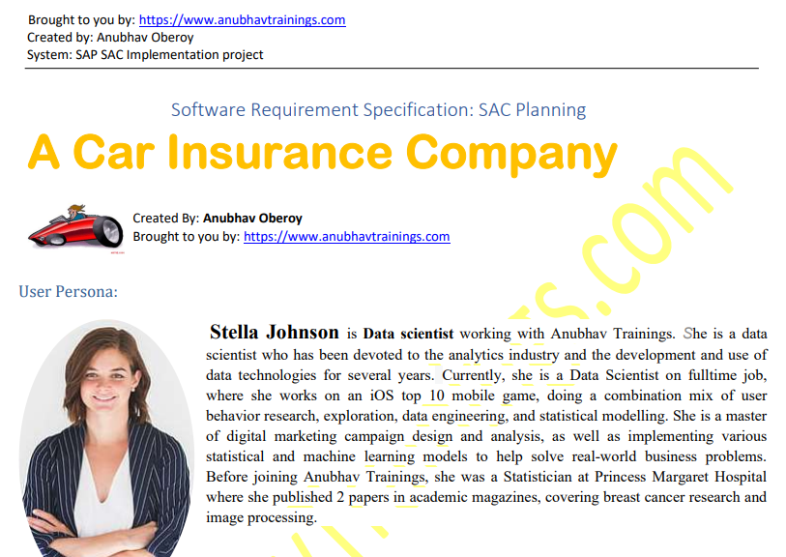
Regression Scenario
www.anubhavtrainings.com

Slide 5
When our output variable of nature continuous, additionally a function of time, in that case we use time series.
We want to predict the value but also the TREND
My company have business in 30 countries, I want to predict sales of next quarter in each country separately. So will you develop 30 ML scenarios (one per country)
Segment = Dimension on which the SAC ML will LOOP

Slide 6
Segmented Time Series
Our goal is to determine target variable which is of continuous nature we use the Segmented time series. The Time series has following differences as compared to Regression
The Trend
The X axis is always Time function
When we want to segmentize the values, Segment is also known as entity.
Trend
Cycles
Fluctuations and Noise
www.anubhavtrainings.com

Slide 7
Time Series Demo Scenario
Please refer the specification document shared by Anubhav.
Create a current Dataset
Create a new model – Simple Story – As of now what's the state
Create a new predictive scenario
And choose segment(Entity) as State
Create a Segmented Time Series Predictive Model for REVENUE
Copy the model and repeat for EXPENDITURE
We will create 2 Data sets, 1 BI Model for Each Dataset
Finally show the Revenue and Exp. In our existing Dashboard
O ds1 exp
BI Models 1
O ds2 rev
BI Models 2
www.anubhavtrainings.com

Slide 8

Time Series Scenario
www.anubhavtrainings.com

Slide 9
Java Script
Java Script is web programming language, you don’t need to learn/know java to learn java script.
Variables
Function
Logic
The simplest way to practice JS is use browser, because all browser’s directly understand JS.
Why to learn JS?
If we want to design an application using SAP analytics cloud which covers custom scenario, we need to use the JS language.
JSON = Java Script Object Notation

Slide 13
End of Day 7
www.anubhavtrainings.com

Slide 15

Questions
www.anubhavtrainings.com

Slide 16

Anubhav Oberoy
anubhav.abap@gmail.com

